Slide 1
C++ Tamagotchi
__
/ \
/ ..|\
(_\ |_)
/ \@'
/ \
_ / ` |
\\/ \ | _\
\ /_ || \\_
\____)|_) \_)
/\_____/\
/ o o \
( == ^ == )
) (
( )
( ( ) ( ) )
(__(__)___(__)__)
__
_/ '>
_ _.-'( )'-._ _
'=._.=-( )-=._.='
|/-\|
Y Y
Eleanor Pahl and Maria Babcock

Slide 2
Style Guide: Functions
void camelCaseFunction() {
/*
Comment at top of function to describe
purpose of function, how it works
*/
}

Slide 3
Style Guide: Classes
Class UppercaseClass : public OtherClass {
/*
Comment explaining purpose of class
*/
private:
string field;
public:
UppercaseClass();
~UppercaseClass();
classFunction(int input);
};

Slide 4
Style Guide: MISC
camelCaseVariableName·=·“Spaces between equals”;
cout<<“No spaces with insertion operators”<<endl;
if (space==“none”) {
// No spaces between equalities
}

Slide 5
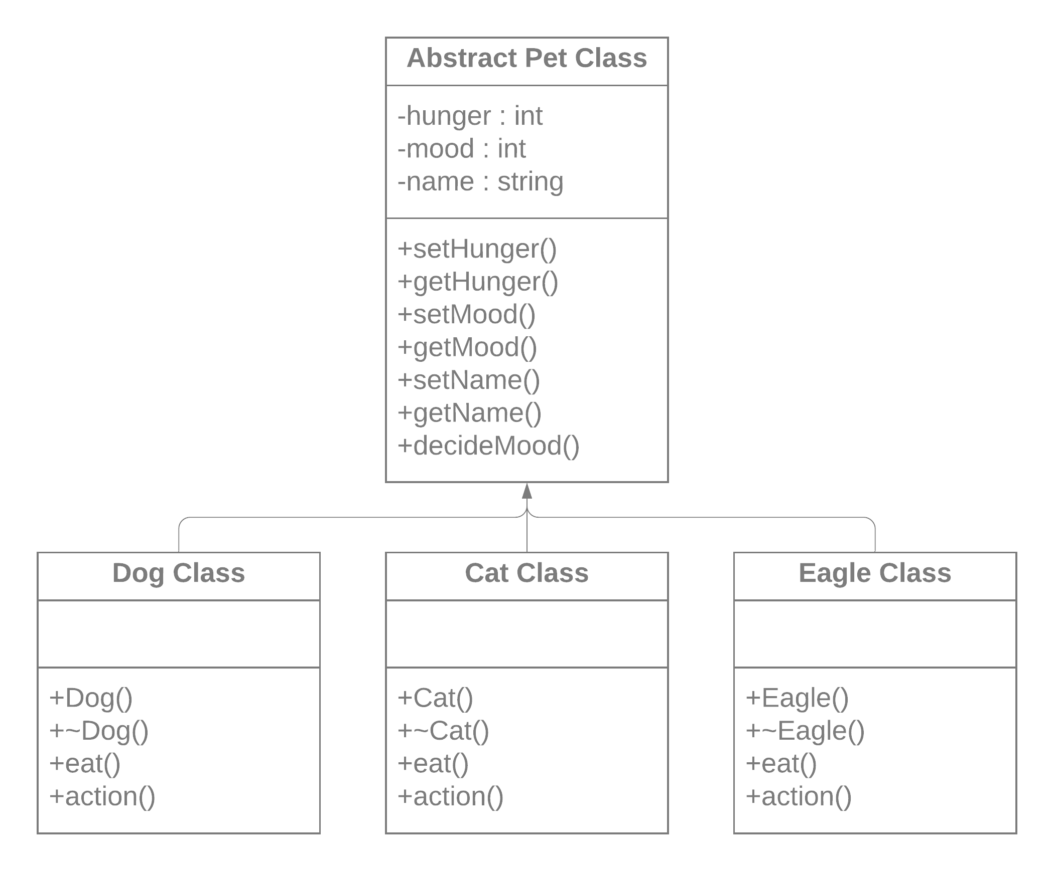
UML Class diagram

